Slide 1
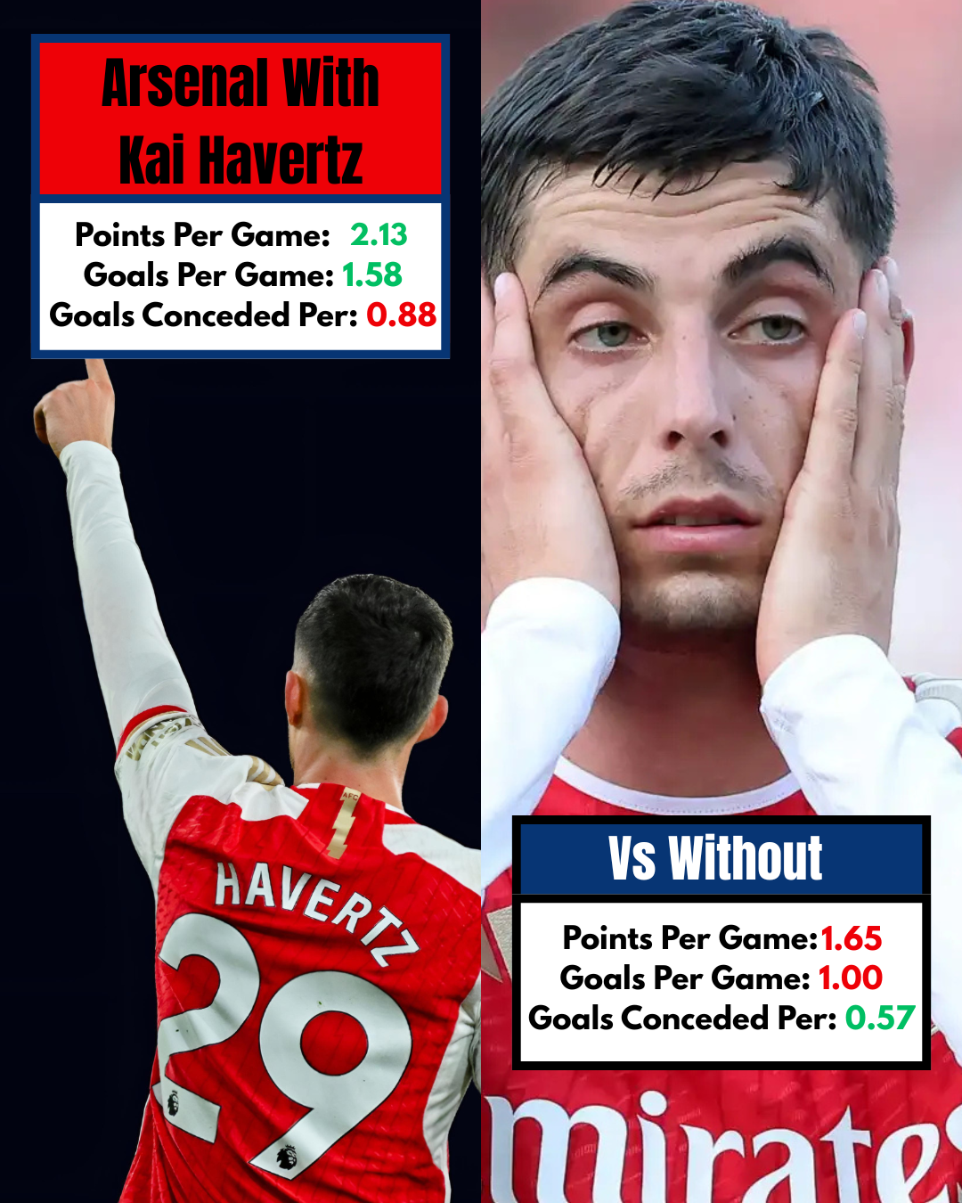
The Havertz Effect: How Havertz Shifts Arsenal’s Match Outcomes
By Matheus Grover

Slide 2
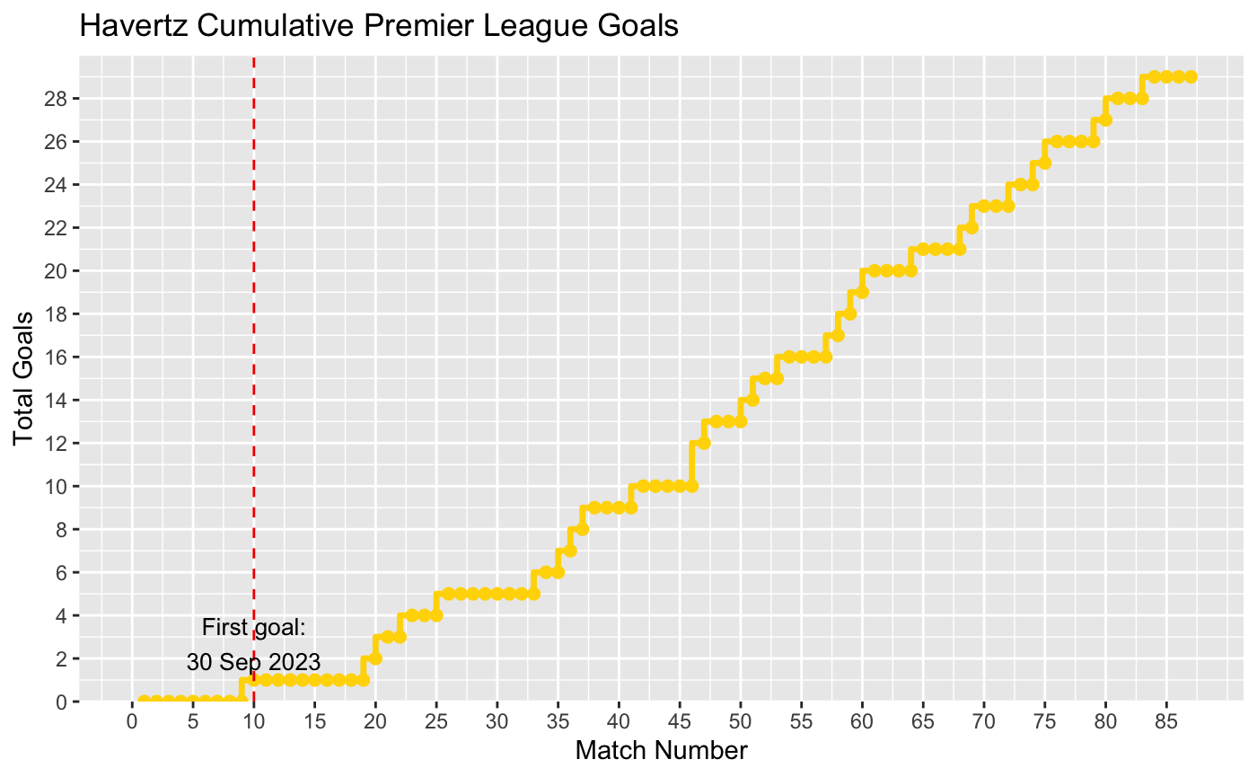
Why Kai Havertz?
Favorite Player
Signed recently (July 2023) for $65 Millions and paid the largest wages on the team
Debate on if he was worth the price or good enough for the team
Hated at first and still a very divisive player
First goal was 10 games into the season and took awhile to find his form

Slide 3
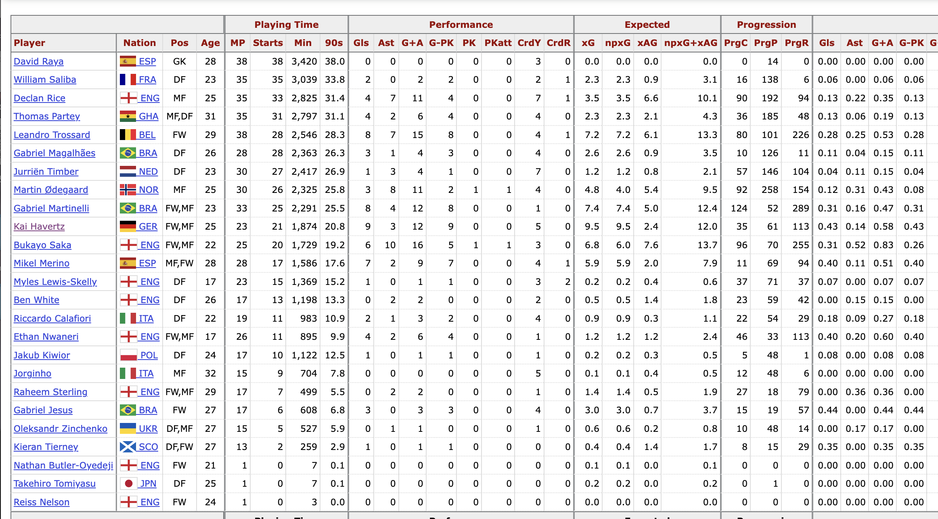
The Data
All Data was scraped from FBREF
110 Matches played
Created 6 CSVs: 23/24 & 24/25
-Havertz Individual Stats
-Arsenal Team Stats
-Arsenal schedule

Slide 4
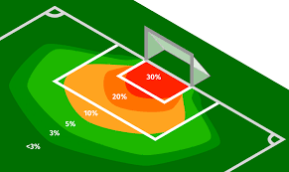
Key Variables for Understanding
Expected Goals(xG): estimates the likelihood that a shot will result in a goal, based on factors like shot location, shot type, assist type, and defensive pressure.
An xG value ranges from 0 to 1, where 1 means a goal is almost certain. It's used to assess the quality of chances and evaluate team or player performance beyond just goals scored.
Points: 3 points for a win, 1 for a draw, 0 for a loss
Win: indicator 0 or 1 for a win
HavertzPlayed: indicator 0 or 1 for if he played
Venue: Home/Away/Neutral
lnxG: log of xG
LnHav_xG: log of Havertz xG

Slide 5
Predictions on how Havertz shifts Arsenal’s match outcomes(points)
I expect the points to be related to the following factors:
Positive effect when Havertz plays:
Positive relationship with Havertz’s individual expected goals(lnHav_xG):
Positive relationship with team expected goals (lnxG):
Positive venue effect: home matches yield more points than away or neutral sites.
Exploratory: the value of Havertz’s xG diminishes when team xG is already high (interaction term).

Slide 6
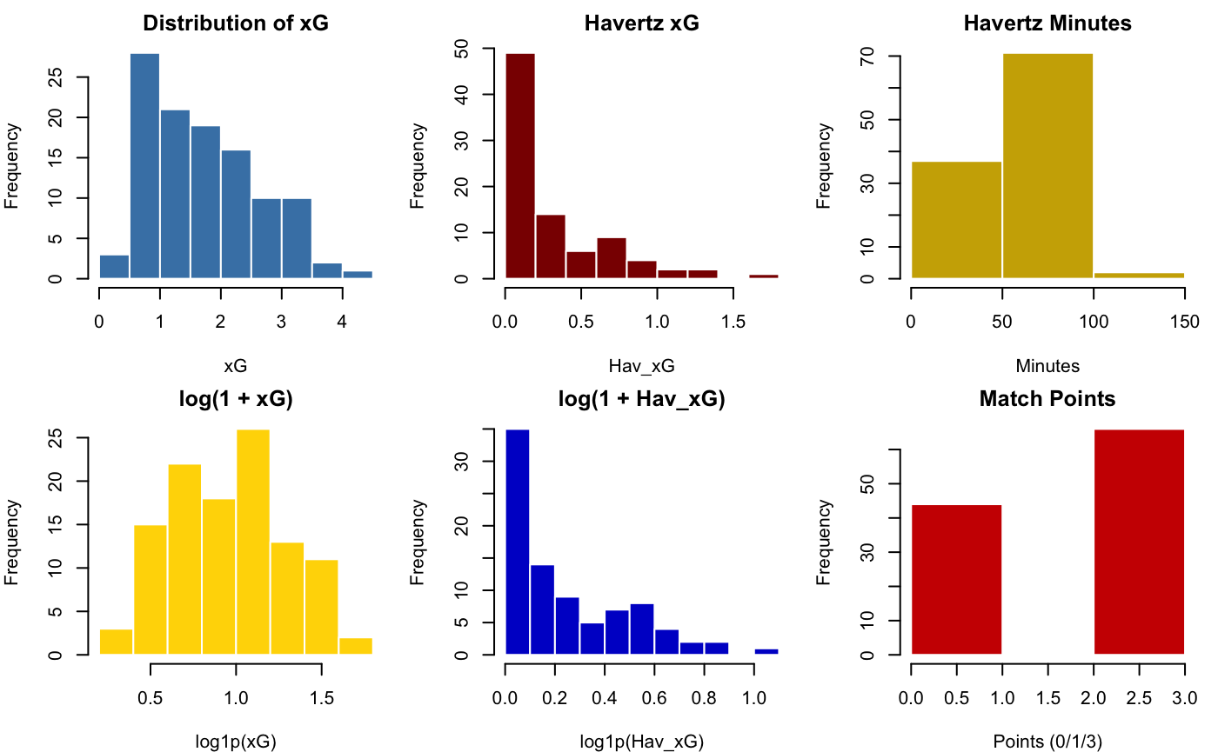
Notes:
We can see both xG and Havertz xG are skewed so we take the log of both variables: xG distribution looks more normal but Havertz xG still has an unavoidable zero mass

Slide 7
Regression Models
M0(Baseline): Points = β0 + β1·HavertzPlayed + β2·xG + β3·Venue + β4·Season + ε
Model clean(Minutes): Points = β0 + β1·Hav_Min + β2·xG + β3·Venue + β4·Season + ε
Model 1(Logged): Points = β0 + β1·Hav_Min + β2·ln(1+xG) + β3·ln(1+Hav_xG) + β4·Venue + ε
Model Int(Interaction): Points = β0 + β1·Hav_Min + β2·ln(1+xG) *β3·ln(1+Hav_xG) + β4·Venue + Season + ε
Notes:
We log-transformed both team and Havertz xG so the model treats a boost from 0.5 to 1.0 xG as more important than a small bump at the high end, and to keep large-xG matches from dominating the fit.

Slide 8
Predictions: Points
Positive effect when Havertz plays: No clear positive effect
M0: 0.44, Not Significant(P=0.16) MC: Almost 0, Not Significant(P=0.75) M1: -0.012, Not Significant(P=0.13)
Positive relationship with Havertz’s individual expected goals: No clear positive effect
M1: 0.624, Not Significant(P=0.32) Mint: 4.12, Significant(P=0.058)
Positive relationship with team expected goals: clear positive effect
M0: 0.38 , Significant(P=0.004) MC: 0.39, Significant(P=0.003) M1: 0.89, Significant(P=0.045) Mint: 1.39 Significant(0.011)
Positive venue effect: home matches yield more points than away or neutral sites: No clear positive effect
Home Games positive in all models but p = 0.26–0.16
Exploratory: the marginal value of Havertz’s xG diminishes when team xG is already high (interaction term): TRUE
M_int: ln xG × ln Hav_xG = -2.71 p = 0.096
This interaction model suggests Havertz’s personal xG converts to points most efficiently in low-xG games, and a bit less when the team is already creating plenty of chances.

Slide 9
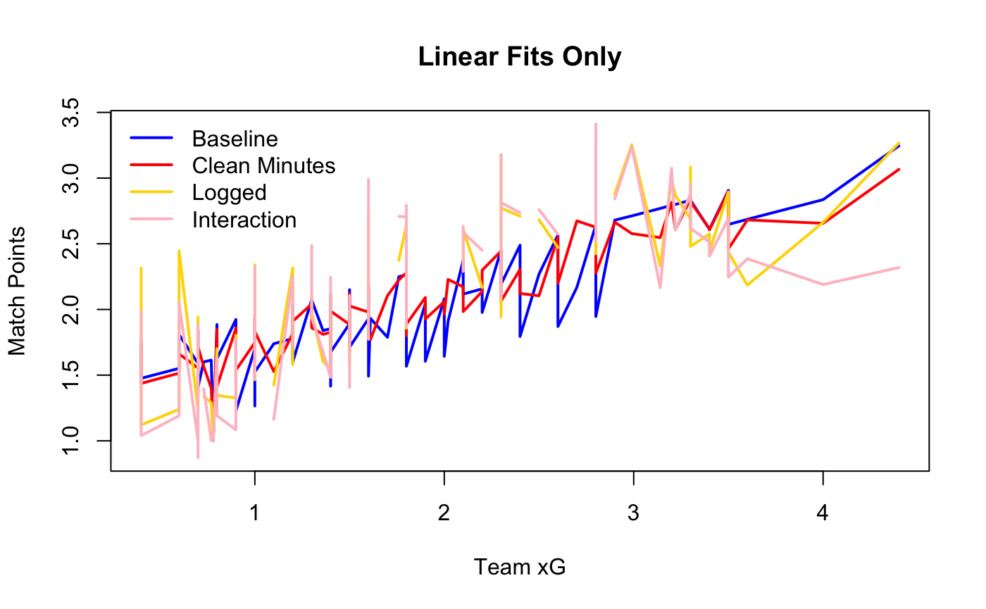
Linear Regression Graph
Here are the four regression models plotted
Its clear do none of these OLS curves can bend to capture potential plateaus, spikes or thresholds in how xG translates to points.
Next step: We need a more flexible fit. In the next slide we’ll use a kernel regression.

Slide 10
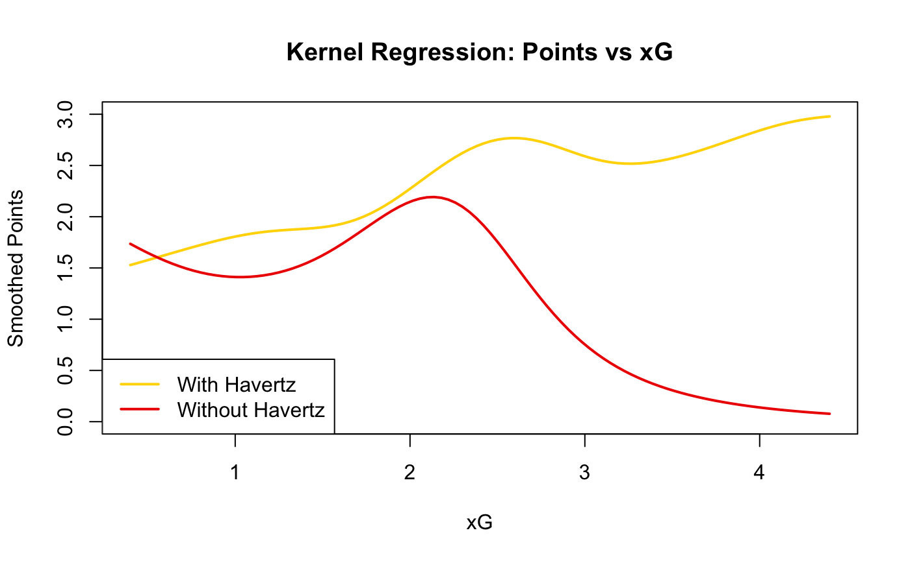
Kernel Regression with C
OLS/Linear Regression forces a straight line between our variables. Kernel Regression allows us to create a smooth curve to spot non-linear patterns
I ran two smoothers and visually compare the xG->Points relationship for games with and without Havertz
Smoother implemented in C for speed
We can see with Havertz points rise steadily with xG
Without him we can see there is a very sharp drop after 2.3 xG which could imply that without him Arsenal generated good chances on goal but failed to convert them into wins.
Havertz appears to help convert the team xG into actual xG. Without him we could still create high xG just couldn’t win the game or score those goals
Notes:
Our Goal is to visualize how arsenals points change with xG and

Slide 11
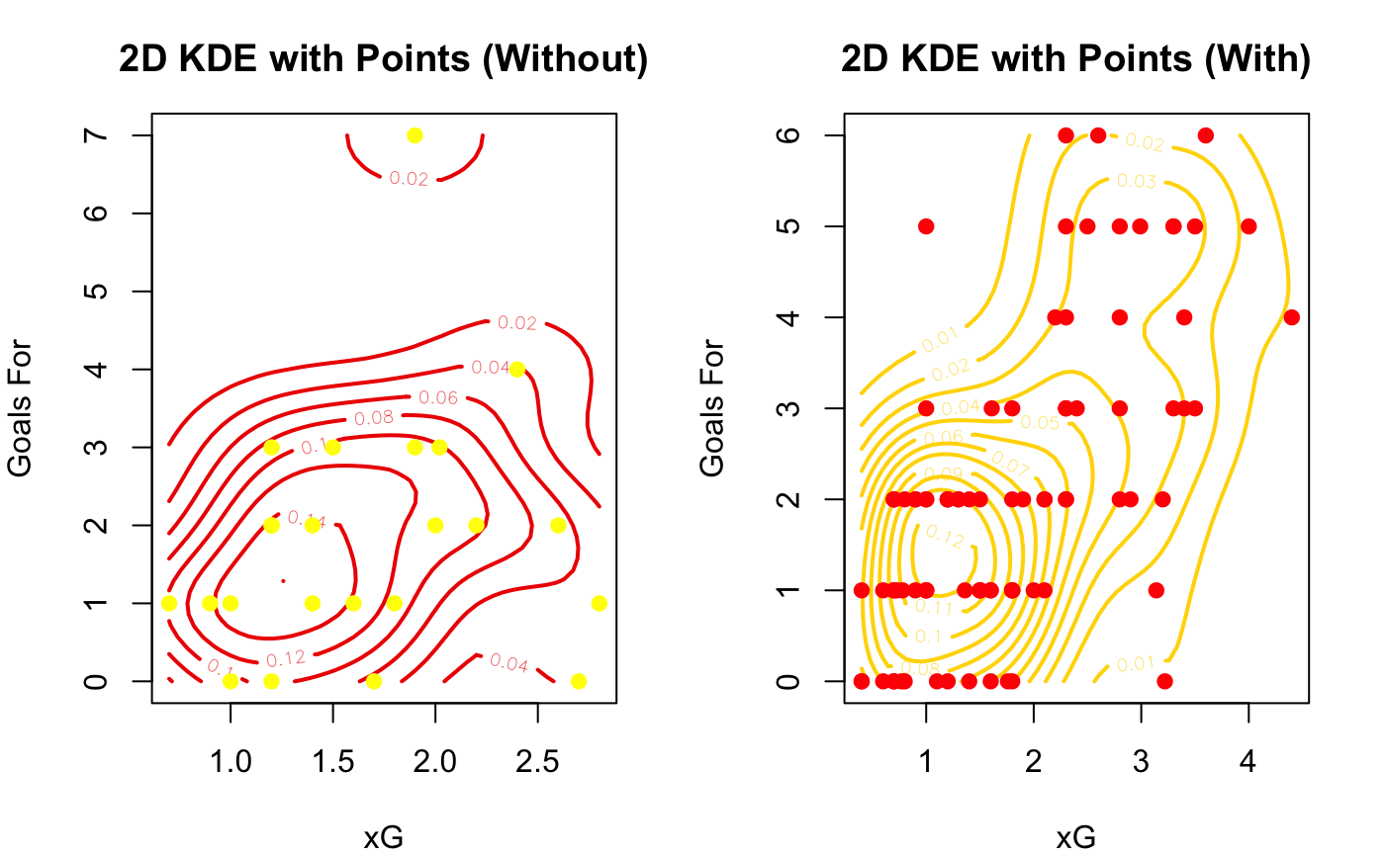
When Arsenal create a similar xG tally, do they turn those chances into goals more effectively with Havertz on the pitch?
Joint Density of xG and GF in matches with and without Havertz
The contour lines are regions of high match density
The dots are actual matches
We saw how points vary with xG now we look at the joint distribution of xG and actual goals and Havertz presence

Slide 12
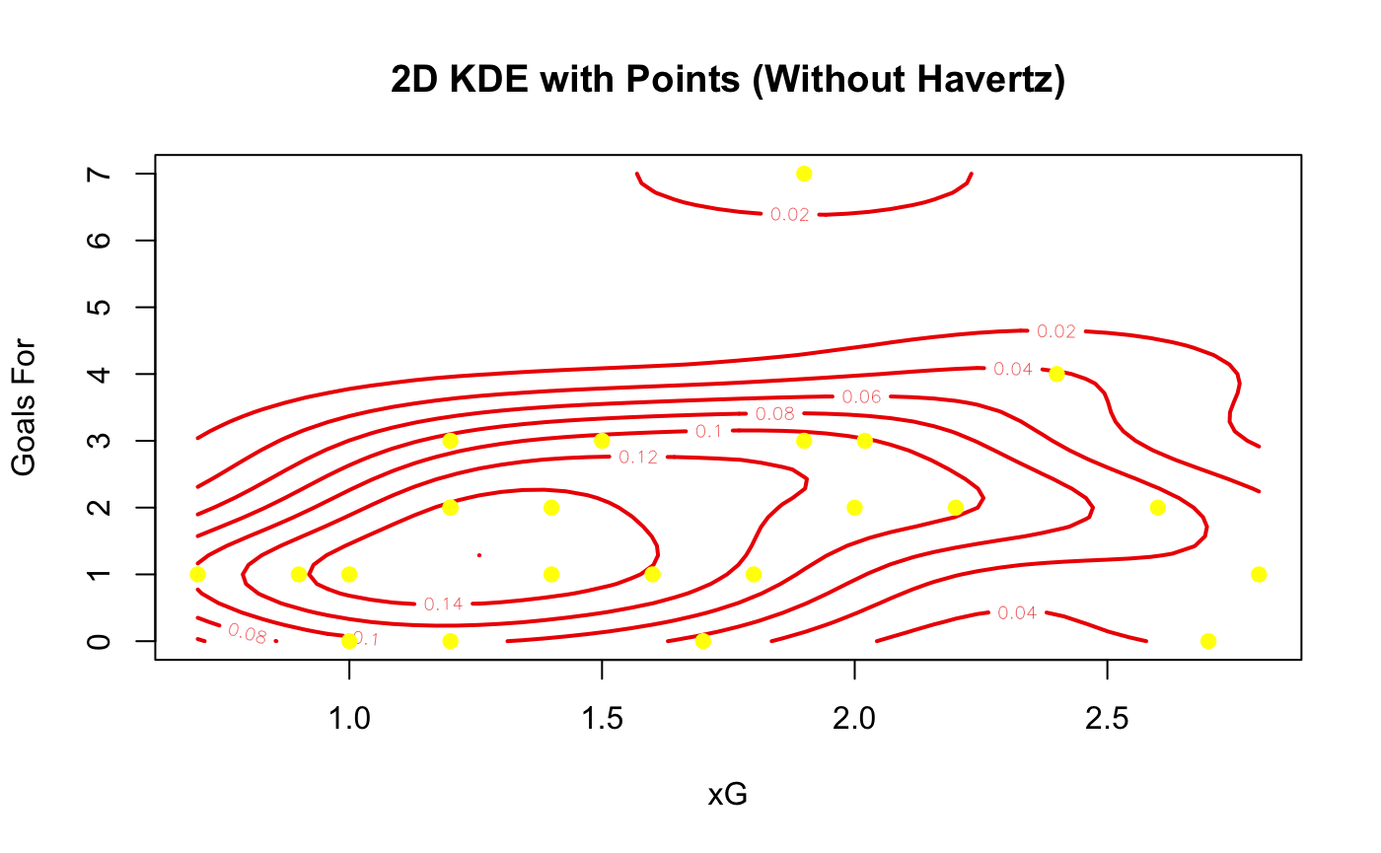
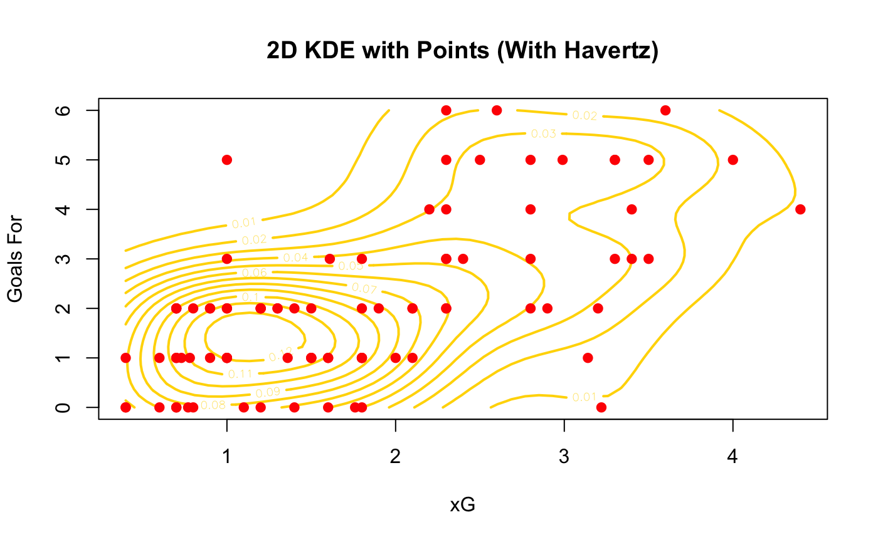
Without
-Without Havertz the cluster is capped around 3 goals and xG doesn’t go above 2.5
-There are fewer high goal matches for a given xG
*note there are fewer matches played without Havertz, so this isn’t conclusive
With
-With Havertz there is a greater density when xG is around 1/1.5 and the Goals are around 1-2
-However, there is a higher tail of 4 to 6 goals when the xG climbs, which shows there is higher ceiling outcomes
-My interpretation of this is that Havertz appearances coincides with a better conversion of xG into goals and a wider goal ceiling which we had already expected from our kernel regression
-TLDR: Havertz presence is associated with more efficient finishing and a higher upside

Slide 13
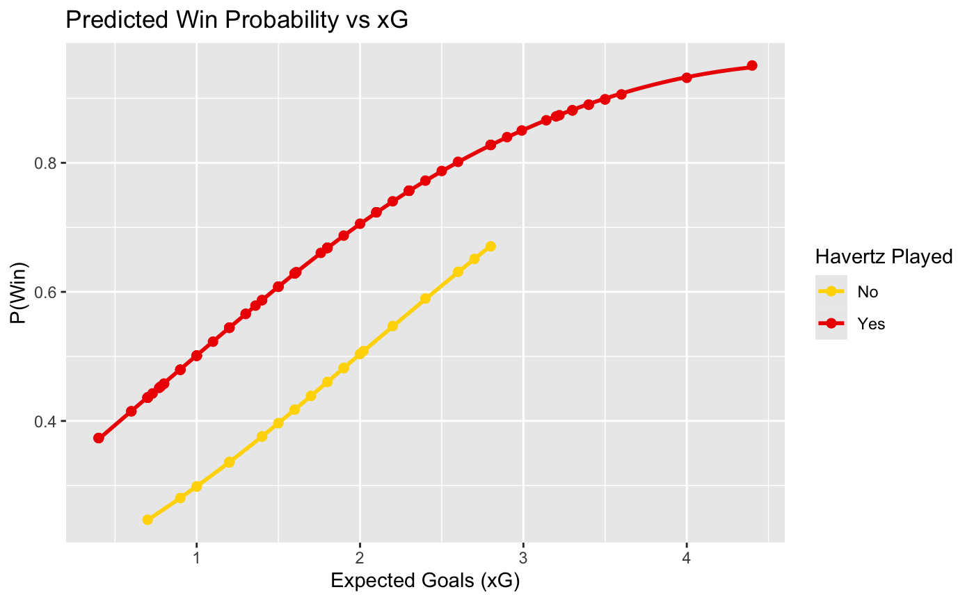
Logistic Regression
This is where we use our new binary variable win
Our Logit Model: Win~xG + HavertzPlayed for estimating how xG and Havertz shift the chance of winning
The coefficient on HavertzPlayed is 0.8589 and when exponentiated is an odds ratio of 2.36 which implies the odds of winning 2.4 times higher(p=0.07) with him and is significant at a 10% level (doubles the odds of Arsenal winning)
Then we take the fitted model and the original data, predict a number between 0 and 1 for each row to guess a P(win)
Points per match predicted prob for each game, LOESS smoothing
-As team xG increases both with and without Havertz the odds of winning increases
-Gap between curves shows that for any team xG the win probability with Havertz is 10-15% higher
*Small no Havertz sample so this isn’t significant yet
Notes:
This highlights does Havertz meaningfully improve the probability of winning

Slide 14
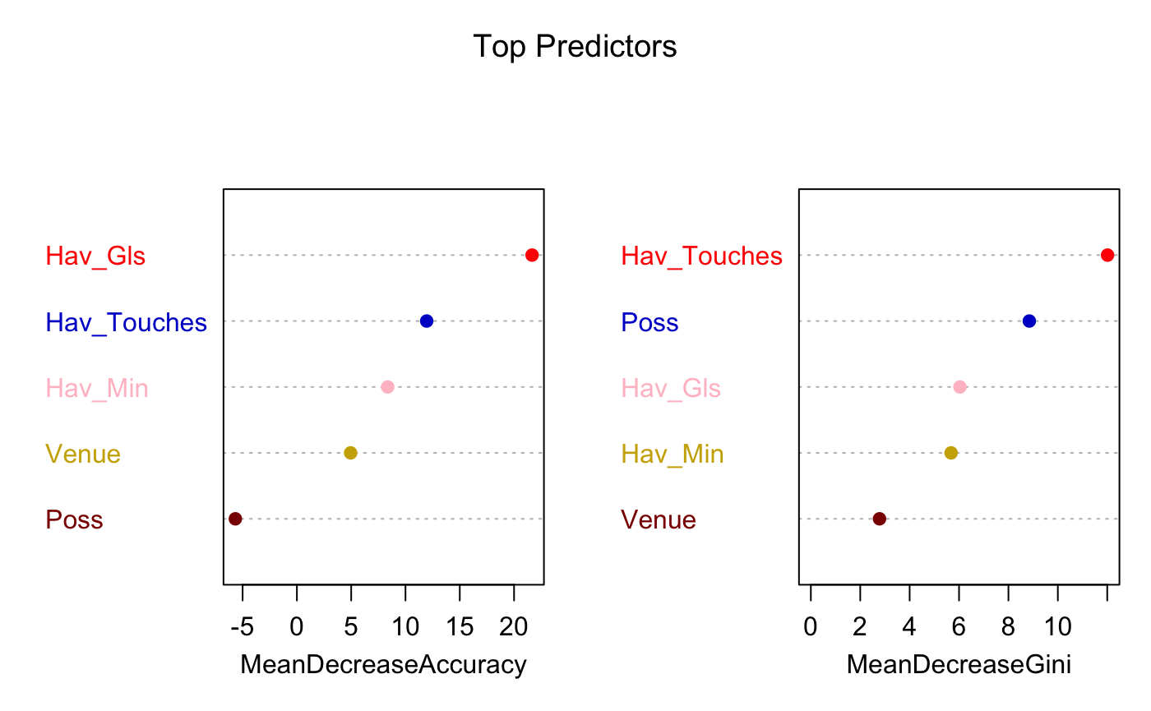
Random Forests
Which Havertz/possession/venue metrics matter most for predicting Win (1 or 0): Random Forest: -110 Matches and 500 trees -OOB error is 31% meaning our forest correctly predicts a win around 69% of the time. Variable importance scores using RF: -The further right the variable is the more important it is to predicting correctly -Havertz Goals increase win likelihood -Touches and Minutes mean more wins -Possession is very weak which is surprising
Notes:
Left: A bigger + value means the model accuracy weakens when not included in the tree Right: Higher Gini means the tree chooses these variables more ofthen: low value means its rarely used or doesn’t improve purity

Slide 15
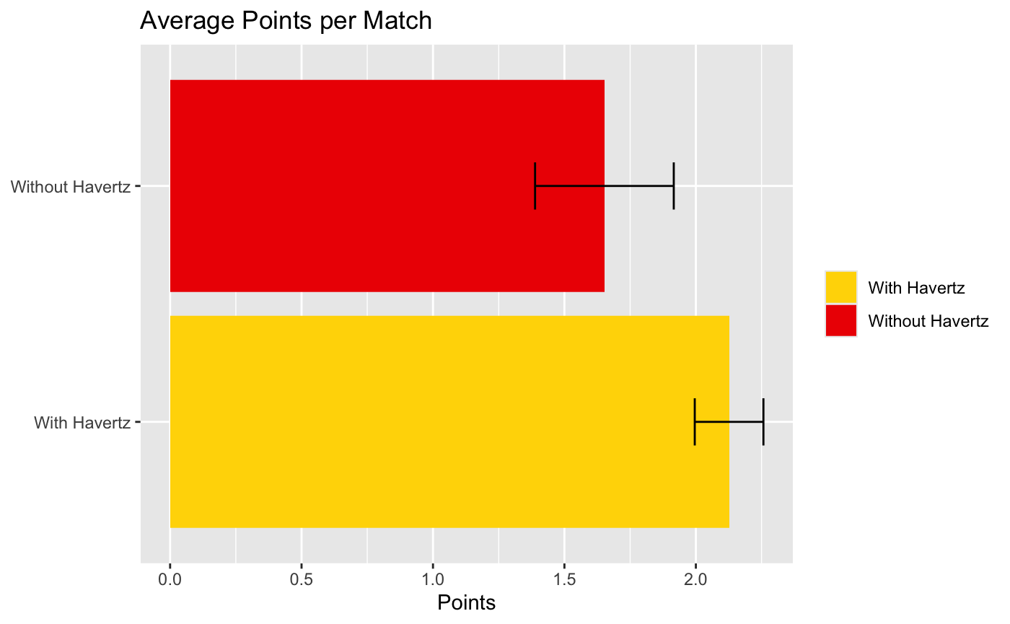
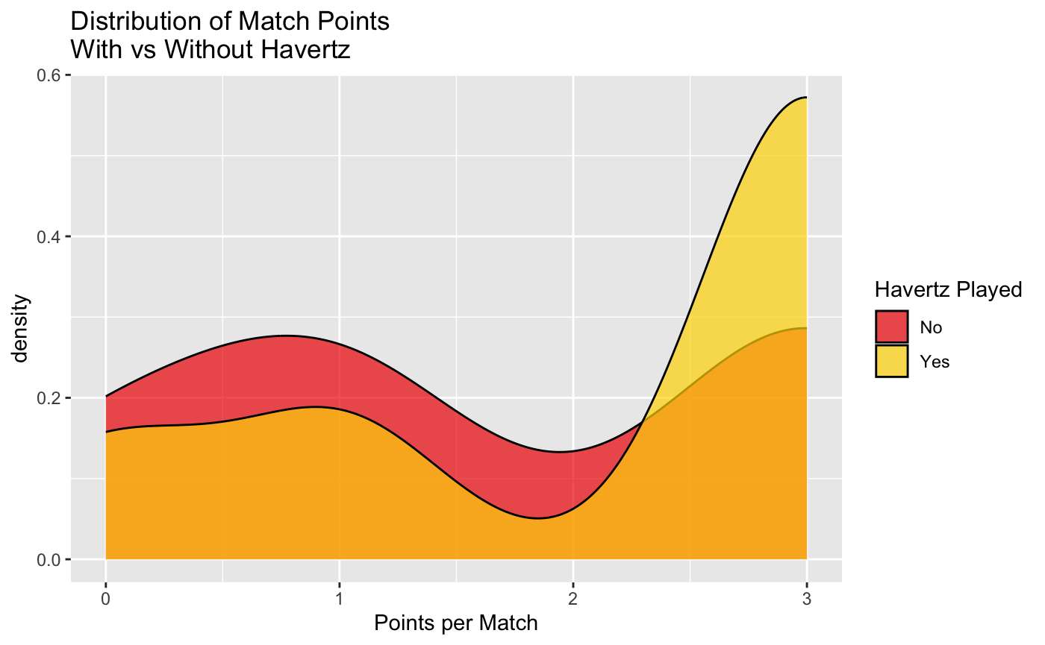
Havertz Impact on Points:
Average Points per Match:
-With Havertz Arsenal averages 2.13 points per game
-Without Havertz Arsenal averages 1.65 points per game
Distribution of Match Points:
-Curve with Havertz skewed towards wins(3pts)
-Without him there's a much larger mass at 0-1 pts
-Fewer low point games when he plays
-Kai Havertz is associated with Arsenal winning more games
Notes:
continuous curve whose total area equals 1, so the taller the curve at a given x-value, the greater the relative likelihood of seeing that value.

Slide 16
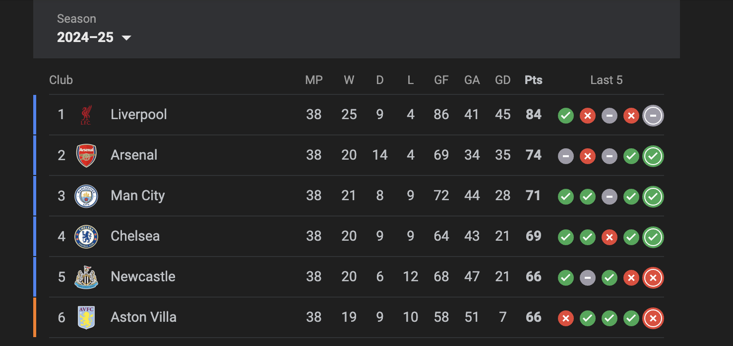
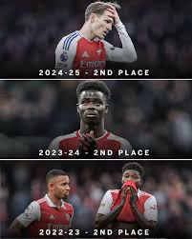
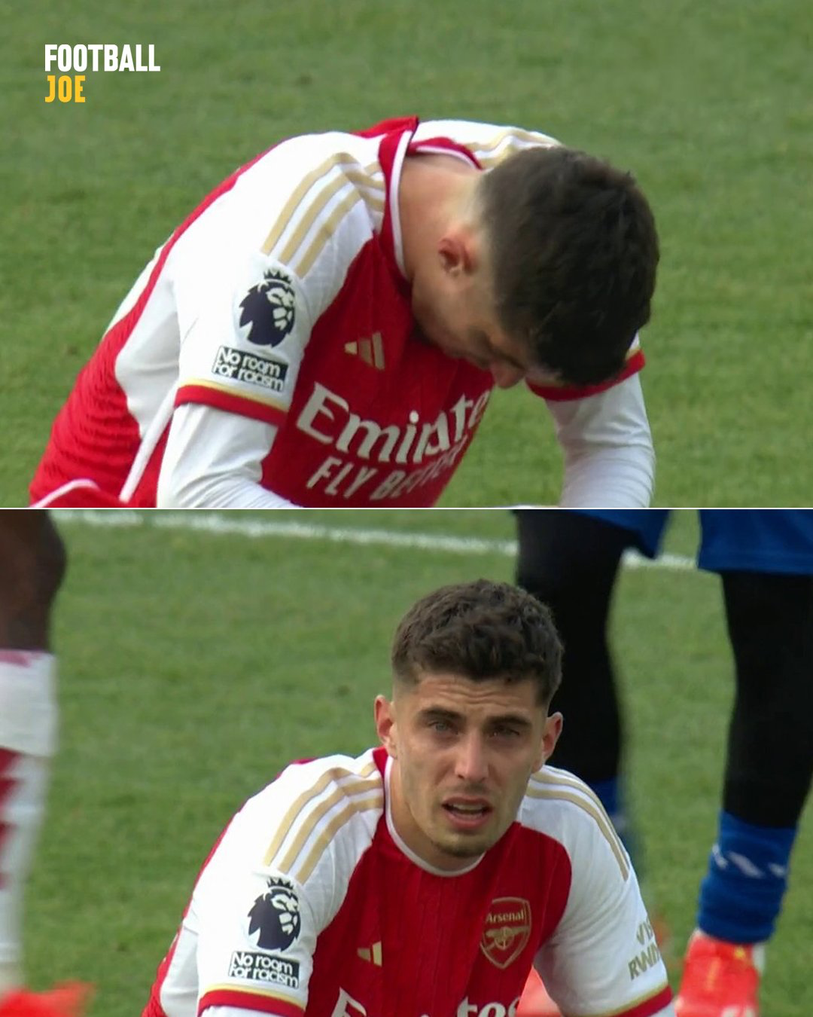

Projected Season Total:
This season Arsenal finished 2nd with 74 points, Havertz missed 15 games where we earned 25 points.
Let’s take those games times our point avg with Havertz:
15x2.13=31.95
74-25 = 49 -> 49+31.95 = 81 points….still 2nd place to Liverpool's 84 points.

Slide 17
Conclusion and Key takeaways across every method
OLS: Linear baseline
-Team xG is the strongest linear driver of points. (Positive and Very Significant)
-Havertz playing alone is not significant once we control for xG, minutes and venue.
Kernel regression: Flexible fit
-With Havertz the xG -> points curve keeps climbing; without him it stalls near 2.3 xG.
-Suggests he helps convert good chances into results.
2-D KDE: Shot quality conversion
-Joint density of xG and goals shows a larger “high-goal, high-xG” tail when he plays.
-Ceiling on goals is lower in matches he misses.
Logit: Match outcome likelihood
-Odds of winning are 2.4x higher with Havertz at any given team xG (p = 0.07)
-Win probability gap is roughly 10–15 percentage points across the xG range.
Random Forest: Non-linear interactions
-Havertz playing ranks as one of the top three predictors of points once non-linear splits are allowed.
Bottom line:
Every model finds the same story: Kai Havertz does not just appear in winning line-ups, he associated with tilting xG into goals and goals into points.

Slide 18
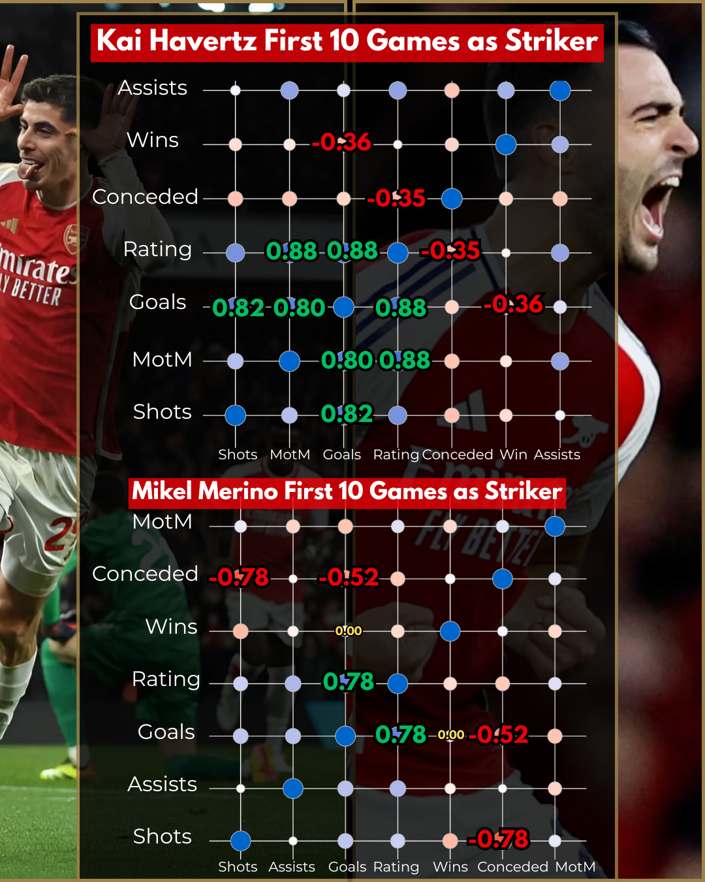
Limitations and future work
Data: Sample without Havertz is small so maybe focus more on minutes/what minutes he played
Need other context variables: What position/other in similar positions, opponent strength, other players around $65 million
xG limitation: Relatively new idea and calculated by FBREF
Thank you!

